Slide 1
Intro to Programming
C/C++
Sankalp Gupta
moklaeducation@gmail.com

Slide 2
Learning Goals
Comfort with
Basics of C/C++
Basics of Computer Science
Familiarity with IDE
Visual Studio Community Edition
Thinking logically
i.e. One step at a time
And Visualizing how computer works
Independence of technology

Slide 3
Why C/C++
Foundational understanding
Understand Computer Science
Speed and control
Fastest programming language
Really small programming language
C has 32 keywords
C++ has 92 keywords as of 2023
Makes you digital native

Slide 4
When NOT C/C++?
Slower manual speed of writing code
Don’t care about speed
Don’t care about deep Computer Science
Although this may not be achievable

Slide 5
Bit : Smallest unit of memory
Bits are used for representing everything
Have 2 states : 0 and 1 , like a bulb
On : 1
Off : 0
Nibble : 4 bits
Byte : 8 bits
int (integer ) 4 bytes
char (character ) 1 byte

Slide 6
Hertz : Unit of time and speed in Computers
1 Hertz : once per second
1 unit of work per clock instruction
Modern processors
Measured in Giga hertz
High Core Counts
More instructions

Slide 7
Hello World
Let’s go ,
Program to print “Hello World”
-----
#include <iostream> using namespace std; int main()
{
cout << “Hello World”; return 0;
}

Slide 8
Print a diamond pattern
*
***
*****
***
*

Slide 9
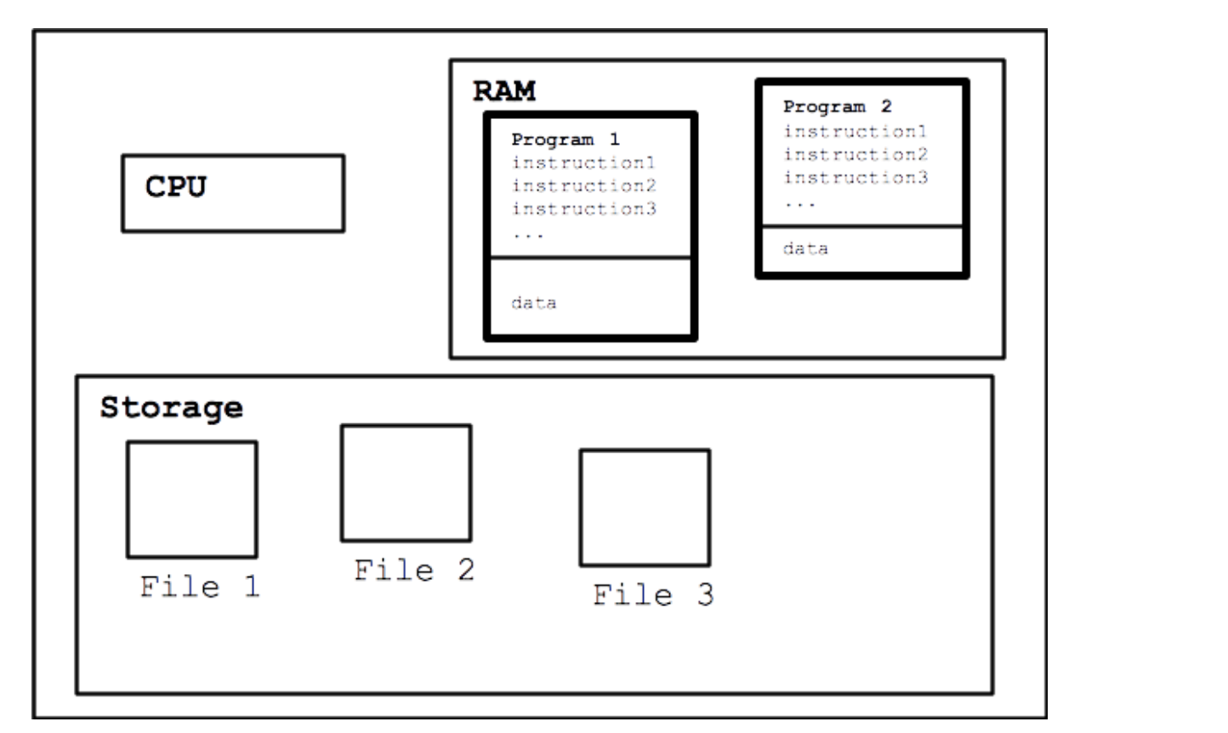
Running the program : model

Slide 10
Data Types(Primitive/built in)
bool
int
short(2), long(4)
signed,unsigned
float
float(4), double(8) , long double(8,10,16)
char(1)
signed,unsigned
wchar_t(2)
void

Slide 11
Variables
Containers for storing data
Value can change during execution (unless you don’t want it to)
Declaration
int birthyear;
float weight;
char courseGrade;

Slide 12
Data Types (Derived)
Arrays
char name[100];
Size 100
Index : 0 - 99
int age[10];
Size 10
Index : 0 - 9
float power[20]
Size 20
Index : 0 - 19

Slide 13
Integer vs floating math
Division
Float :continuos, contains decimal point
Int : discrete , truncates everything after decimal ,
float f = 10;
cout << f/3;
3.33
int i = 10;
cout<< i/3;
3

Slide 14
For reference …. | no need to | memorize
Type Name | Bytes | Other Names | Range of Values
int | 4 | signed | -2,147,483,648 to 2,147,483,647
unsigned int | 4 | unsigned | 0 to 4,294,967,295
bool | 1 | none | false or true
char | 1 | none | -128 to 127 by default
signed char | 1 | none | -128 to 127
unsigned char | 1 | none | 0 to 255
short | 2 | short int, signed short int | -32,768 to 32,767
unsigned short | 2 | unsigned short int | 0 to 65,535
long | 4 | long int, signed long int | -2,147,483,648 to 2,147,483,647
unsigned long | 4 | unsigned long int | 0 to 4,294,967,295
long long | 8 | None | -9,223,372,036,854,775,808 to 9,223,372,036,854,775,807
unsigned long long | 8 | none | 0 to 18,446,744,073,709,551,615
enum | varies | None
float | 4 | None | 3.4E +/- 38 (seven digits)
double | 8 | None | 1.7E +/- 308 (fifteen digits)
long double | 8 | None | Same as double
wchar_t | 2 |  | 0 to 65,535

Slide 15
User Defined Data Type
Enum
Short for enumeration
Define a set of named, integer constants
enum ESpeed { low, medium, high }; ESpeed fanSpeed; fanSpeed = low;

Slide 16
Code : Greeting with name/age
Given user
Store name in char array ( char name[100] )
Store year of birth in int( int birthyear)
Calculate age
age = currentYear – birthyear;
Print Name, age.
cout <<“Hello “
<< name <<“ I know your age is :“ <<age;

Slide 17
Advanced : Count digits in a number
Define a number
Return the number of digits, (assume positive)
129 → 3
34 → 2
0 → 1
Hints
You need to know loops
while
You need to know integer maths
division

Slide 18
Input , Output and Processing for Humans
Speech
Process →Speak →Listen
Book
Read →Process → Memorize
Conversation
Listen → Speak →Listen →Speak ….

Slide 19
I/O and processing for Computers
Video games
Input (controllers) →Process →Output (Screen)
Movies
Input (network) →Process → Output (visuals, audio)
Console
Input(char, int, float) → Process →Output (char(s), int, float)

Slide 20
Standard Input
cin
Read data from keyboard
Store it in variables
Extraction operator
>>
Can use multiple data types ( char, int, float , …)
Example
int age;
cin >> age;

Slide 21
Standard Output
cout
Write data to console/Screen
Reads from memory
Insertion operator
<<
Can use multiple data types(variables, literals, constants)
Example
int age = 172;
cout << age;

Slide 22
Operators >>,<<
Extraction and Insertion operators
Can be cascaded
cin >>age >> name;
cout<<age << name;
<< works with stream modifiers
“\n” : newline
cout <<“\n”; //moves the cursor to new line
Or cout <<endl; //Same visual effect as “\n” but is different
(there are other stream modifiers too)

Slide 23
Lab
Using Cin ( Hint: define a variable first)
Input a character (char)
Input an integer(int)
Input a decimal( float)
Using cout
Output a character
Output an integer
Output a decimal.
Use endl and “\n”
Cascade the operators

Slide 24
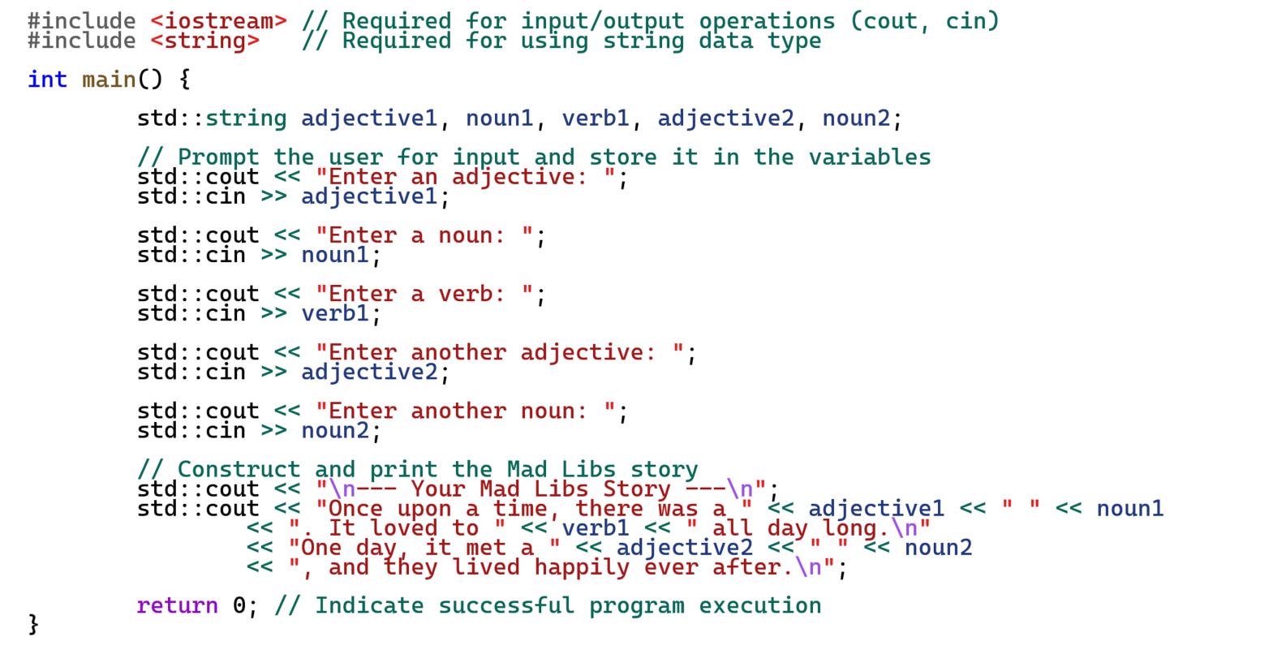
Assignment : Mad libs story

Slide 25
Boss Assignment
Input student details
Student Name
Subject name
Marks ( out of 100)
Process
Find grade using this table
90 <marks →A
75 <= marks < 90 →B
60 <= marks <=74 →C
marks <60 →D
Output
Grade for the student
Challenge
Enter multiple students, print how many students had A, B , C and D grades each.
Hint
Need to know conditional (if-else)
May need to know loop (while)

Slide 26
Recall , Review
C/C++Keywords we know already
And few more
signed , unsigned
short , long
Computers think in 0s and 1s
What types ?
Computer have speed measured in hertz (Hz)
How much faster is 1Kilo Hertz than 1Hz ?
What are current computer speeds ?

Slide 27
Measuring computer capabilities (some more units)
FLOPS : floating point operations per second
FP 16, FP 32, FP 64
IOPS : Input/Output operations per second
Fun facts
Computers are afraid of floats
Computers are afraid of division

Slide 28
Computer trends
Getting smaller
Die sizes have been shrinking
Getting faster
Same size die have more transistors
Getting crowded
More core counts per die
Getting chatty
Networked , internet connected
Getting efficient
More performance per unit of power

Slide 29
Back to C++, Decision Making & Branching
if , else
switch
goto

Slide 30
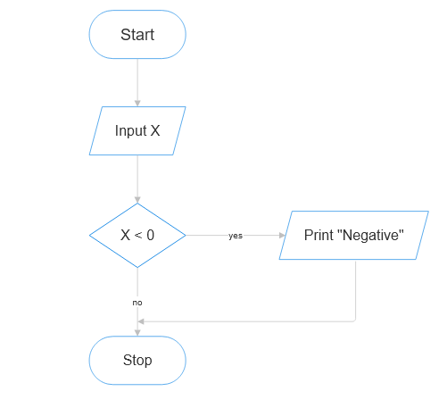
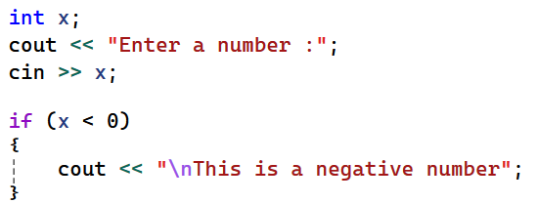
Making Decisions , using “if”

Slide 31
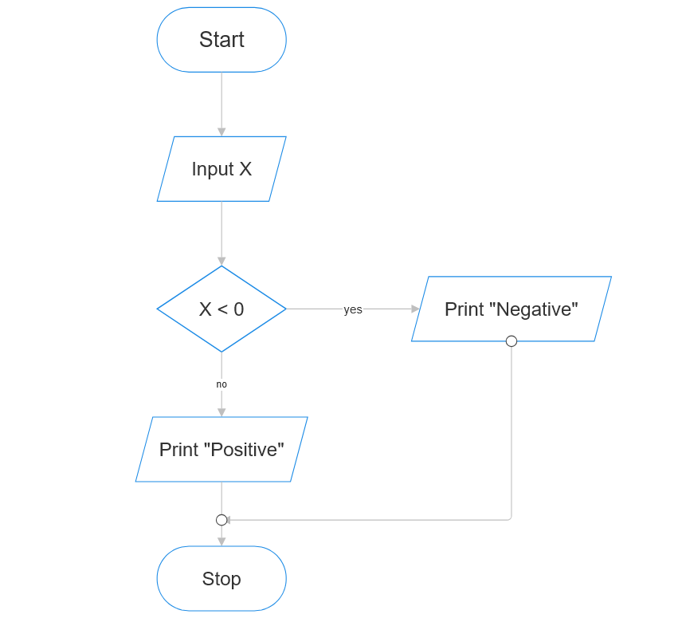
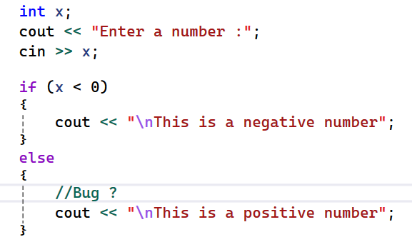
Making Decisions using “if else”

Slide 32
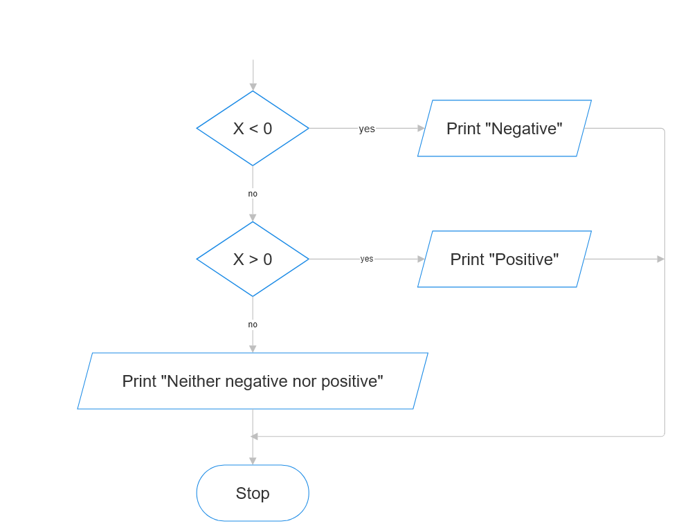
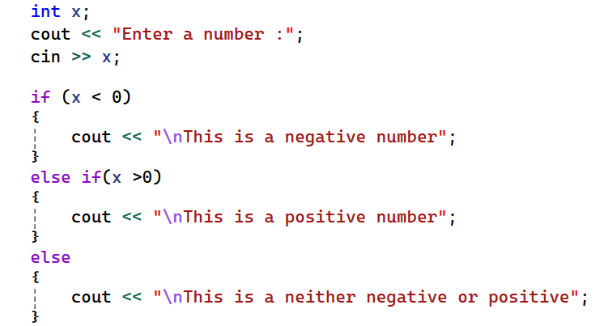
Making decision, If else if else

Slide 33
Relational operators
less than
<
greater than
>
less then or equal to
<=
greater than or equal to
>=
is equal to
==
is not equal to
!=

Slide 34
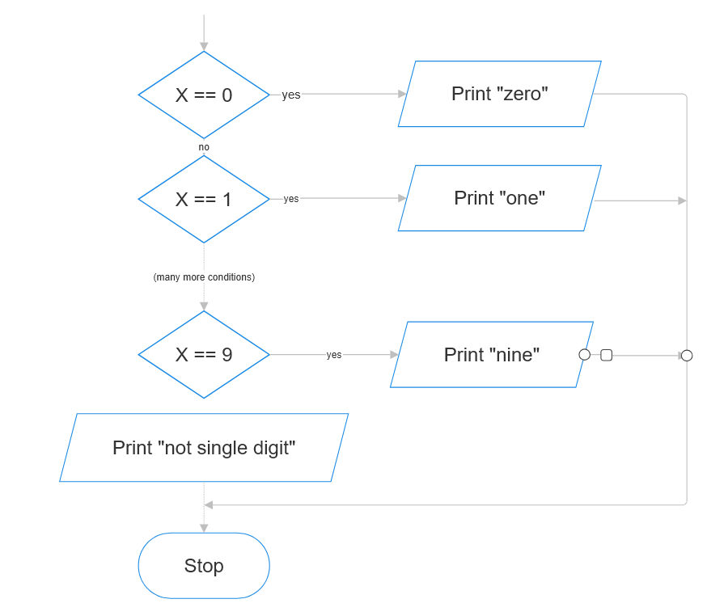
Lab (if else)
Get user to enter a single digit number
Print the digit in English
0 → “zero”
1 → “one”
…
8 → “eight”
9 → “nine”
(Anything else) “→ this is not a single digit number”

Slide 35
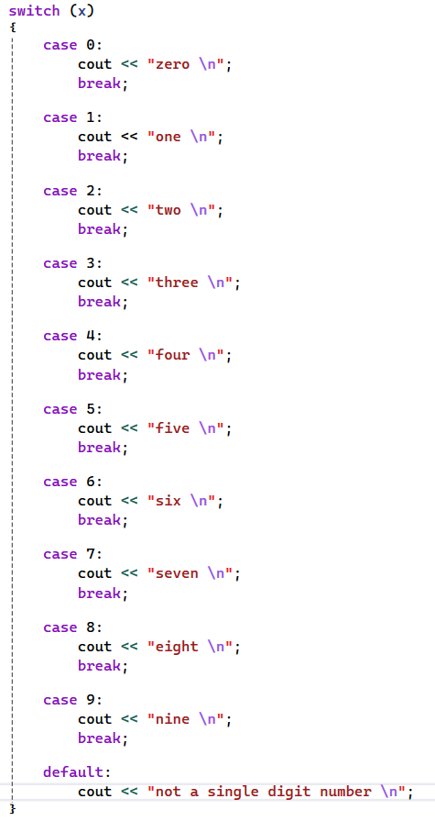
Branching using Switch

Slide 36
Lab (switch)
Get user to enter a single digit number from [1,2,3,4,5,6,7]
Convert it into day of week
1 → “Sunday”
2 → “Monday”
3→ “Tuesday”
4 → “Wednesday”
5 → “Thursday”
6 → “Friday”
7 → “Saturday”
(Anything else) → “Invalid number for a day”

Slide 37
Asssignment , quiz game
Create a quiz game containing atleast 3 questions.
Print a question ,
provide 4 numbered options ,
User enters the option number and verifies result.
Keep score of how many correct responses user input
Print the score (e.g.3 /4 correct , )
An example Q1. What is the capital of USA ?
1. Seattle
2. Los Angeles
3. Washington DC
4. Chicago
Enter your response : _

Slide 38
Boss Assignment Convert a string of 0,1 to decimal
Get a string of 0s and 1s from user
Calculate what the decimal number for it is ?
Note
This is very hard , may take hours/days/weeks
Hint
You would need to know
string (or char array)
Loops (while)
Binary logic
*Loops within loops

Slide 39
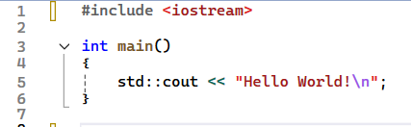
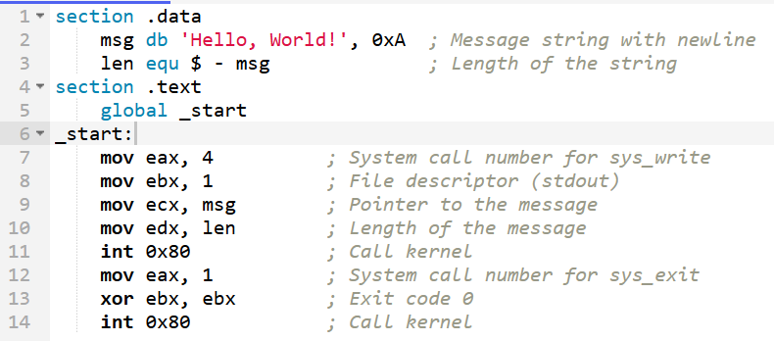
Code, as seen by computer : HelloWorld
Cpp vs assembly

Slide 40
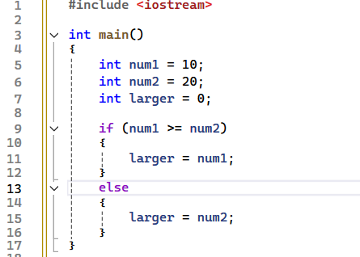
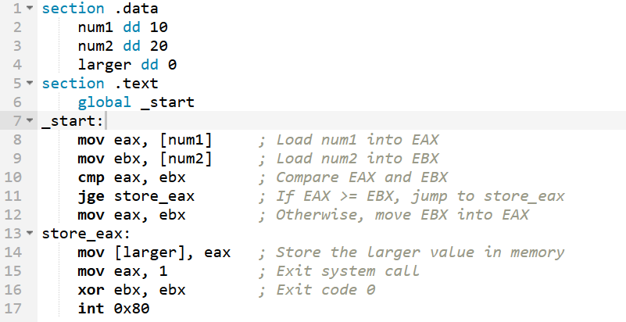
Code , as seen by computer : Find larger num.
Cpp vs Assembly

Slide 41
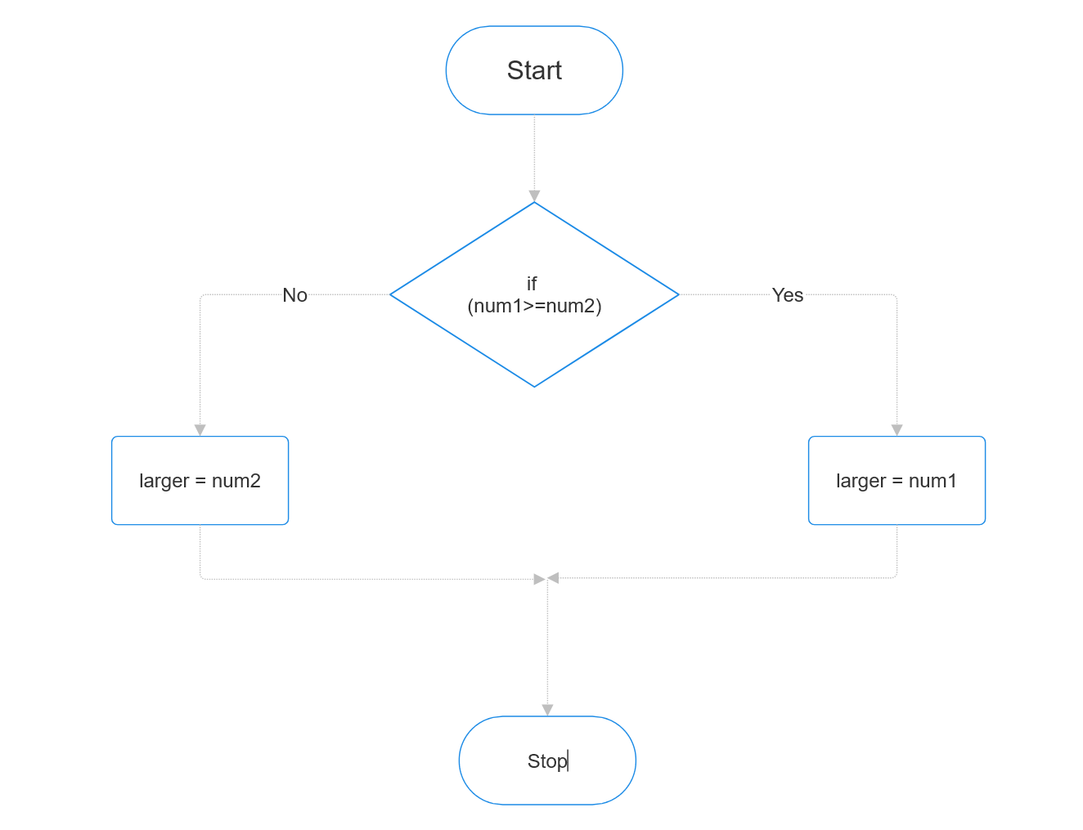
Branching visualized
Code looks sequential
But really has branches

Slide 42
Loops : Things that happen over and over …
Years
…,2024,2025, …
Seasons
Spring, summer, fall, winter
School
Learn , Homework, Tests
Scoring
Reading a book
Title,… page, page,page …,the end

Slide 43
Decision making and looping
Loops
Print “Hello”10 times
10 x cout ?
What if 100 times ?
100 x cout ??
Can we do better ?

Slide 44
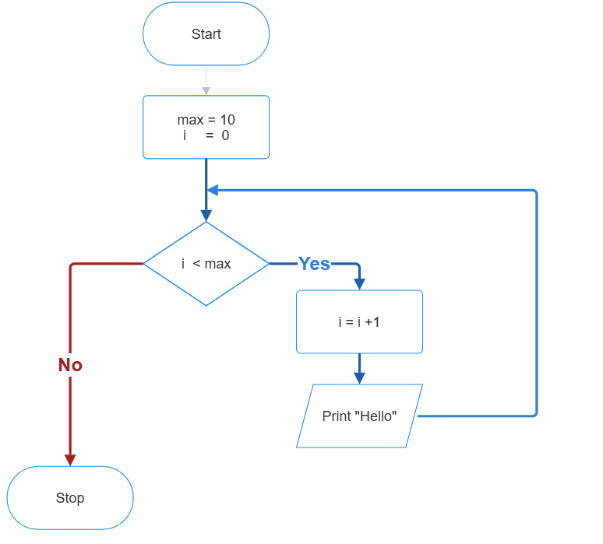
Loop : visualized
Print “Hello”10 times

Slide 45
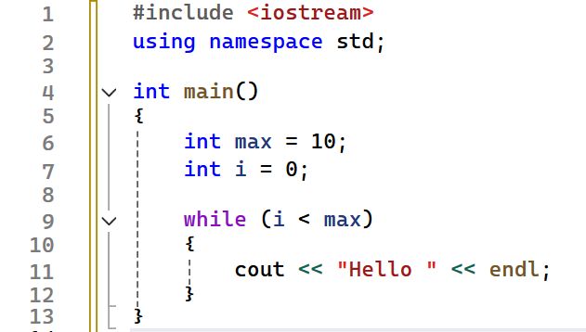
Loop : visualized
Print “Hello”10 times

Slide 46
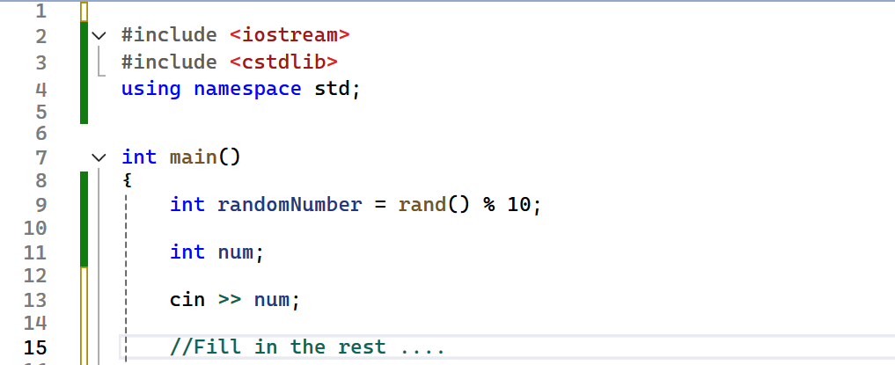
Assignment 1, Guess the number
Computer finds a random number between 0..9
User guesses it
If user fails .. they try again … (*use while loop)

Slide 47
Boss Assignment
Get a number from user
Convert the number(int) into binary.
Examples
0 → 0
1 → 1
7 → 111
8 →1000
12→1100
15 →1111

Slide 48
Assignment 2.* (hint : use while)
Print first 10 numbers
Print the sum of first N numbers
N is provided by the user
Find the sum of first N odd numbers
Find smallest number divisible by all numbers between 1 to 20.
Find the greatest common factor of 2 numbers .
2,4 → 2
6,9 → 3
EASYMEDIUMHARD

Slide 49
Decision Making at a glance
Branching
If/else
slides 30 - 32
switch
goto
Looping
while
slide 45
do/while
for
Jumps in loops
break
continue

Slide 50
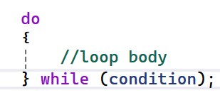
Do-while loop
Do-while is an exit controlled loop
( while is entry controlled)
When loop content should execute at least once
E.g
Looping until user enters valid value
Gather game input for game loop

Slide 51
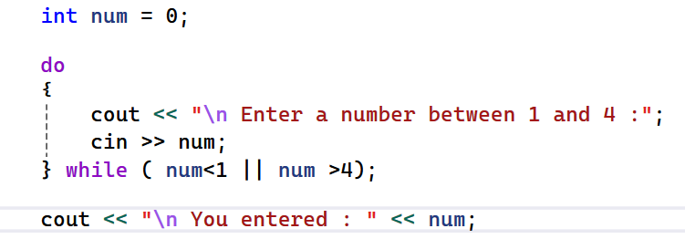
Do while : example
Get a number between 1 and 4 from user.
Ask again if the numbers is not in range
Print the number and stop if it is in range.

Slide 52
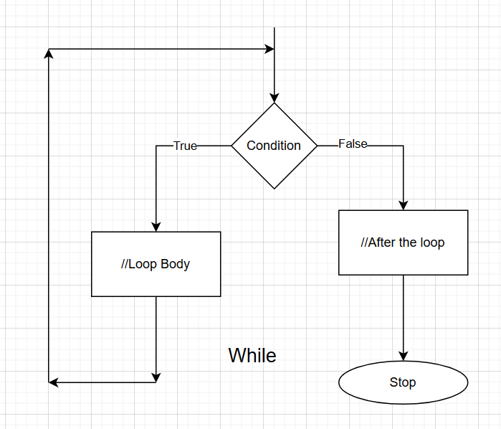
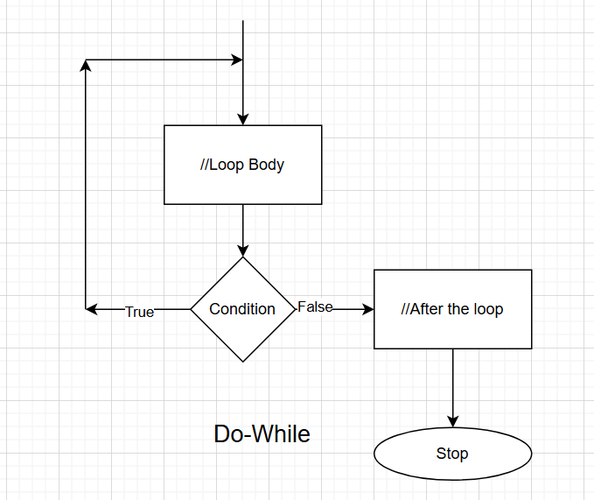
While vs do-while, visualized

Slide 53
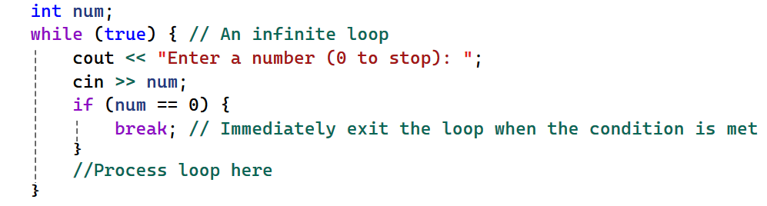
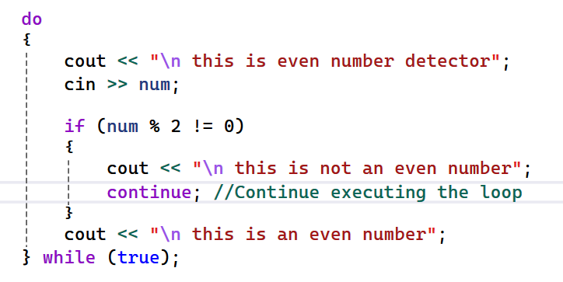
Jumps in loops
Break
Jump to after the end of loop
Loop does not execute
Continue
Jump to the beginning of the loop
Loop continues to execute

Slide 54
Assignment 1: Create a menu driven calculator
Enter 2 numbers
Get user option ( 0 to 5) repeatedly
1 → add the two numbers and print
2 → subtract 2nd from first number and print
3 → multiply the two numbers and print
4 →divide 2nd by first number and print
5 →do nothing , and restart
0 →stop the loop
Try using both loops and compare result
while
Do/while
Use break and continue

Slide 55
Boss Assignment: Menu driven multi purpose program
Create a multi purpose program running until user enters 0
Enter 2 numbers e.g. a, b;
Get user options repeatedly and perform the operation
1 → find the least common multiple of 2 numbers
2 → find the highest common factor of the 2 numbers
3 → find ‘a’ raised to the power of ‘b’ using loops : a^{b}
4 → find 1/a^{b} using loops
5 → do something random from between 1 and 4
#include<cstdlib >
int rand = 1+ rand()%4;
0 → Exit the program

Slide 56
string data type
We already know few built in types
int , float , char, bool
string
Is a derived data type,
Useful for names, description etc.
Header
#include<string>
Usage
string name;
cin >> name;
cout <<name;

